Slide 1
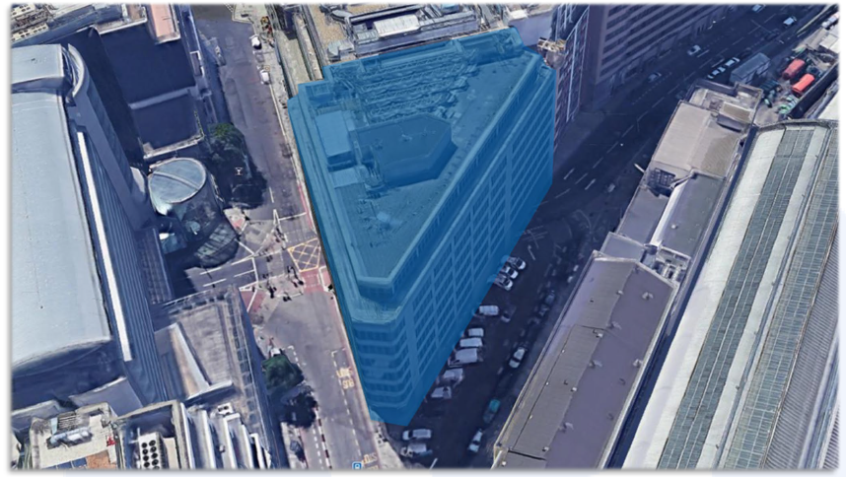
Erith Contractors Ltd
Stockley House Community Liaison Group Meeting 1
5th June 2022

Slide 2
INTRODUCTIONS
Stuart Accleton Operations Director
Pete Lilburn
Project Manager

Slide 3
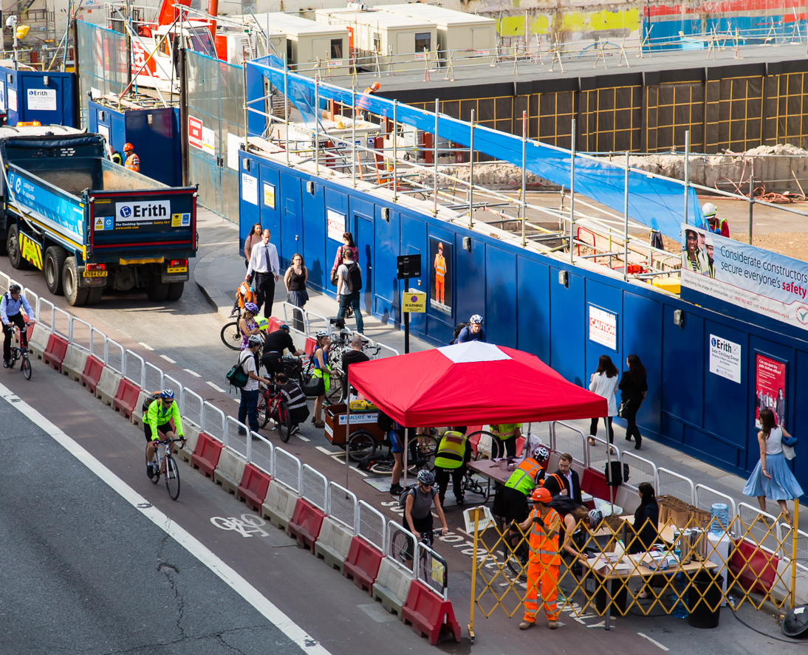
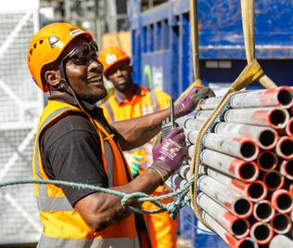
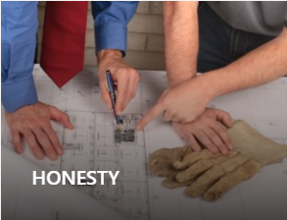
INTRODUCTION TO ERITH
E is for Excellence
R is for Respect
I is for Integrity
T is for Teamwork
H is for Honesty

Slide 4
IN-HOUSE DEPARTMENTS

Slide 5
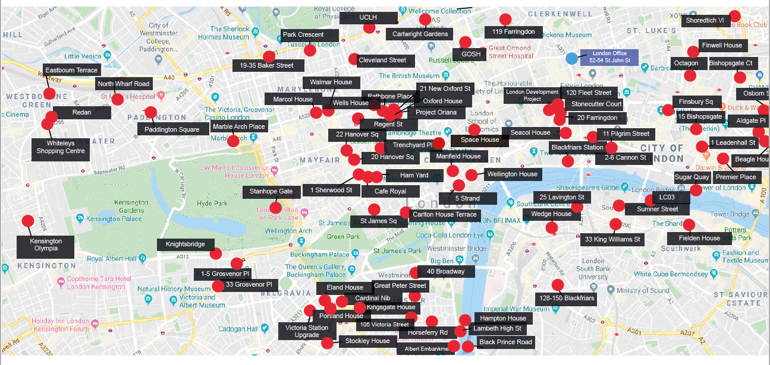
LONDON PROJECTS

Slide 6
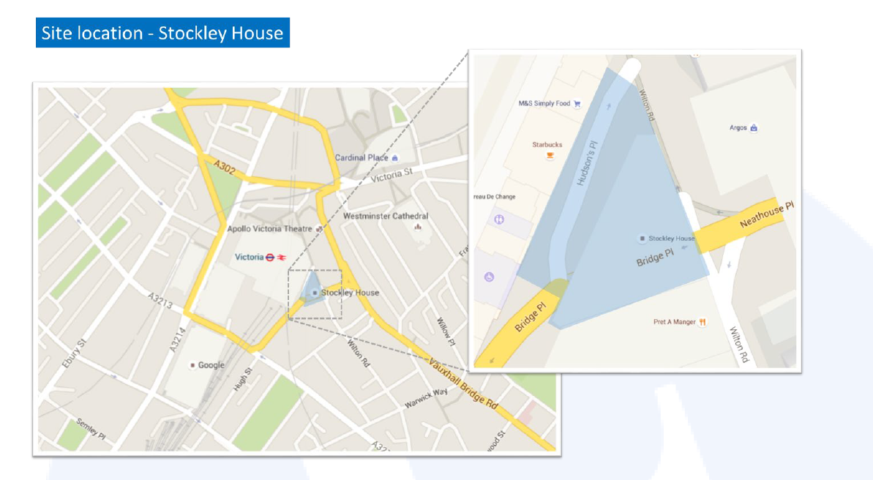
STOCKLY HOUSE - Location

Slide 7
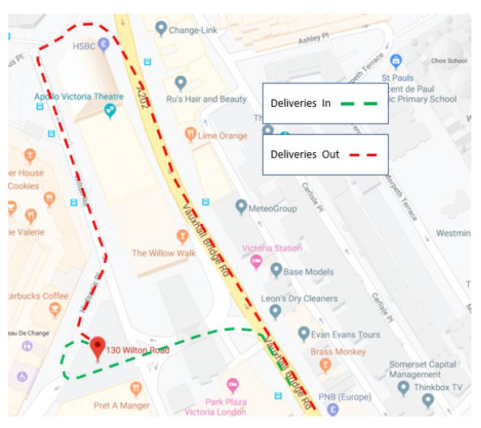
STOCKLY HOUSE – Traffic Routes

Slide 8
STOCKLEY HOUSE – Project Programme
Start Date – 18th July 2020
Site Set Up – 2 Weeks
Scaffold Erection – 12 Weeks starting 25th July
Demolition Phase – 24 weeks starting 18th October
Project Completion 23rd March 2023

Slide 9
STOCKLEY HOUSE – Working Hours & Site Security
Monday – Friday 8am-6pm
Noisy Working Hours 8-10am, 12-2pm & 4-6pm
Saturday 8am-1pm No Noisy Works

Slide 10
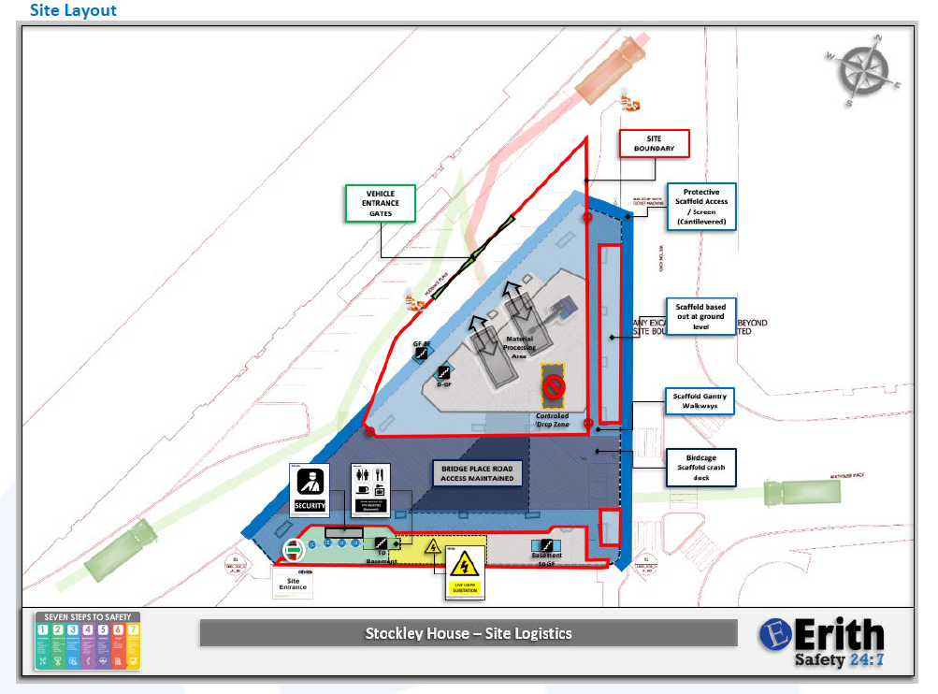
STOCKLEY HOUSE – Site Logistics

Slide 11
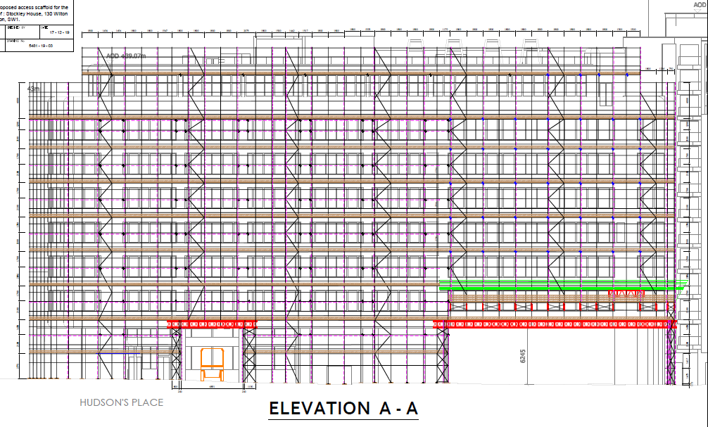
STOCKLEY HOUSE – Scaffolding

Slide 12
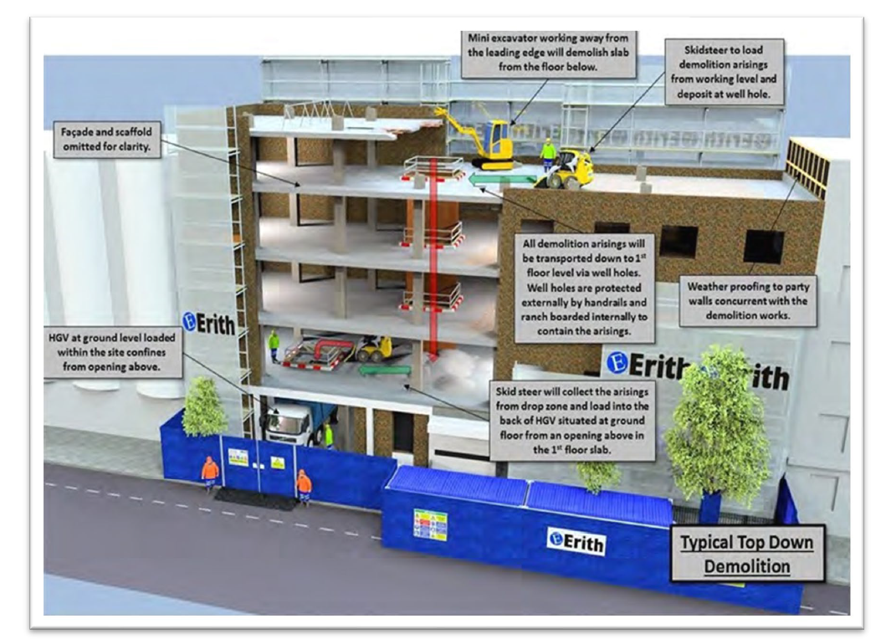
STOCKLEY HOUSE – Demolition Works

Slide 13
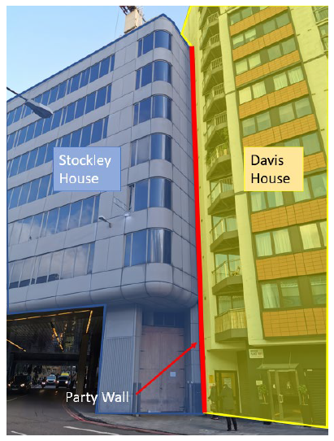
STOCKLEY HOUSE – Demolition Works

Slide 14
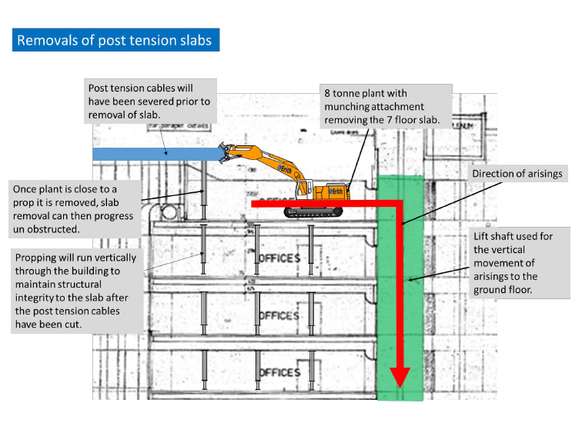
STOCKLEY HOUSE – Demolition Works

Slide 15
STOCKLEY HOUSE – Environmental Monitoring
Westminster City Council
Code of Construction Practice
Section 61 Agreement
Real time Monitoring
Noise – 75 dBa
Dust – Moinitored to PM2
Vibration
Residential 1mm/s
Commercial 3mm/s

Slide 16
STOCKLEY HOUSE – Neighbourhood Liaison
Continuous Liaison with neighbouring residents, business groups and adjoining party walls.
Stuart Accleton
Operations Director
Pete Lilburn Senior Project Manager
Cherrie O Kane
Head of Community Liaison
Fiona Ireland Community Liaison Officer
Farhana Rouf
Community Liaison Representative
Katie Simms
Community Liaison Representative
Sonam Sabharwal
Community Liaison Representative
Laverne Fawthrop
Environmental & Sustainability Lead
Erith recognise that one of the key factors in delivering this project will be community relations. We intend to do this by;
Liaising with local residents / business group representatives
^{Publishing monthly newsletters}
^{Dedicated 24hr contact number}
Collaborate with the local school to host a ‘fun day’ for the children
^{Working with local charities}
Erith Contractors Limited have always strived to lead sustainability within the demolition industry, with a strong track record of delivering sustainable solutions and innovations for our clients. This includes:
Market leading circular economy schemes, such as Verde SW1,
Consistent attainment of BREEAM credits and exemplary environmental performance.
In order to assist the delivery of projects in line with the UK Green Building Council’s Net Zero Carbon Buildings Framework Definition and our own target of setting and achieving a Science-Based Target for reduction of carbon emissions

Slide 17
ANY QIUESTIONS?

